Slide 1

Natchez Trace Council, BSA
United Methodist Church Update
January 26 & 31, 2023

Slide 2
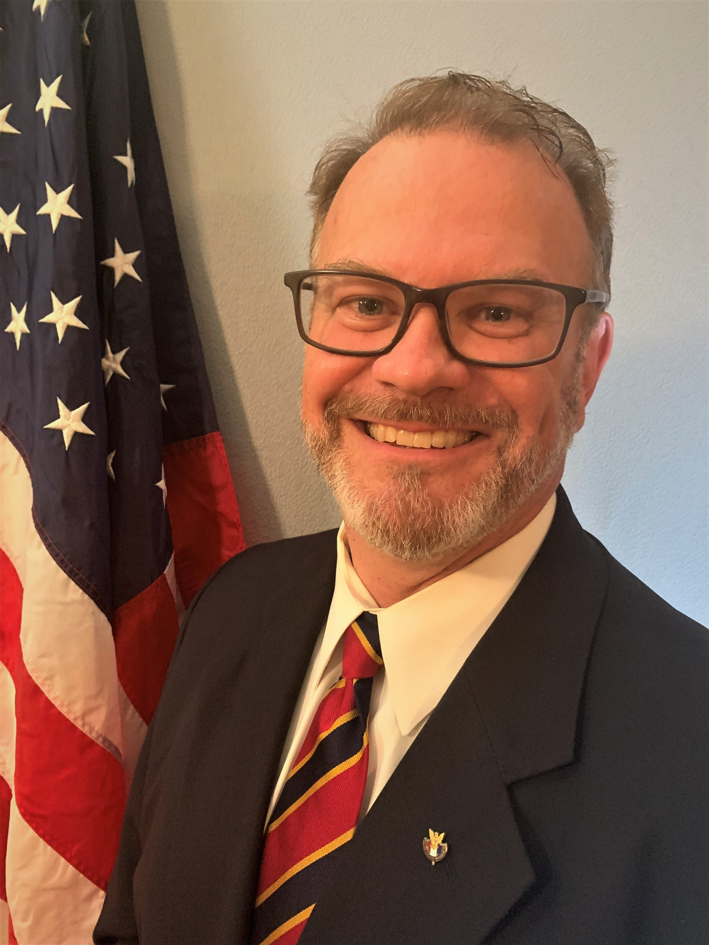
Call Agenda
Welcome - BSA Update
United Methodist Church & the BSA
Unit Options
Insurance
Traditional Charter Agreement
Q & A
Owen McCulloch
Scout Executive
See additional information at www.NatchezTraceCouncil.org/UMC

Slide 3
Boy Scouts of America
2022 Year-End Goal
1,025,000
December 2022 Year-End Final Numbers

Slide 4

246,673 NEW YOUTH OR 89.70% OF THE 275,000 FALL NEW YOUTH GOAL
(AUG –DEC)
2022 Total New Youth
Council Operations – December 2022 processed on 1-1-2023, 7:34AM, my.Scouting –Council Membership Tools

Slide 5
2022 Membership and Unit Report
Includes Total Cub Scouting, Scouts BSA, Venturing and Exploring
Council Operations – December 2022 processed on 1-1-2023, 7:34AM, my.Scouting –Council Membership Tools

Slide 6
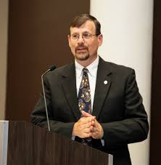
Steven Scheid, Director
Center for Scouting Ministries
General Commission on United Methodist Men
United Methodist Church & the BSA

Slide 7
United Methodist Church Partnership
100 + Year Relationship
A strong desire by church leaders to preserve our Relationship
Significant contribution to the Victims Trust
6,600+ Chartered Units
132,751 Youth Served
78,099 Adult Leaders
A New Model – Affiliation Agreement (“AA”) – NTC Board not approved
Facilities Use Agreement (“FUA”)
7
Notes:
Steven

Slide 8
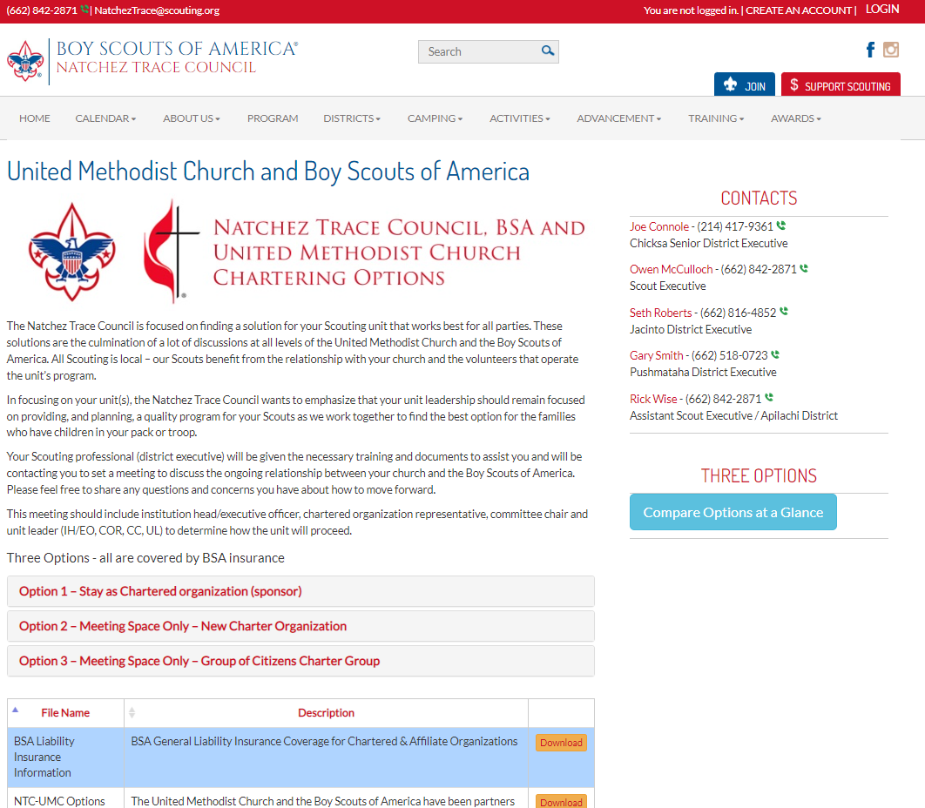
Unit Options
Visit: www.NatchezTraceCouncil.org/UMC

Slide 9
Local Council Unit Options for UMC
Stay as Current chartered organization (sponsor)
This continues the existing charter relationship; the UMC continues to provide a meeting place, the unit(s) continue to identify with the UMC as their chartered organization, and liability insurance coverage continues.
Meeting space only – New Charter Organization (other than United Methodist Church)
The Natchez Trace Council, unit, and local United Methodist Church work to secure a new charter organization that aligns with the principles, policies, and leadership standards of the Boy Scouts of America. Under this method, the approved Facilities Use Agreement with the local United Methodist Church will enable the unit to continue to meet at the church and to store equipment at the church’s discretion. Liability insurance coverage continues.
Meeting space only – Group of Citizens charter group
While the formation of units in connection with existing organizations is preferred, when conditions warrant, the Local Council may grant a charter for the formation of a unit independent of any relationship with an existing organization. Liability insurance coverage continues.
Local councils have the sole authority to grant and issue charters to units in accordance to BSA policy
BSA units may not incorporate (LLC) or seek tax exempt status
9
Notes:
Jeff

Slide 10
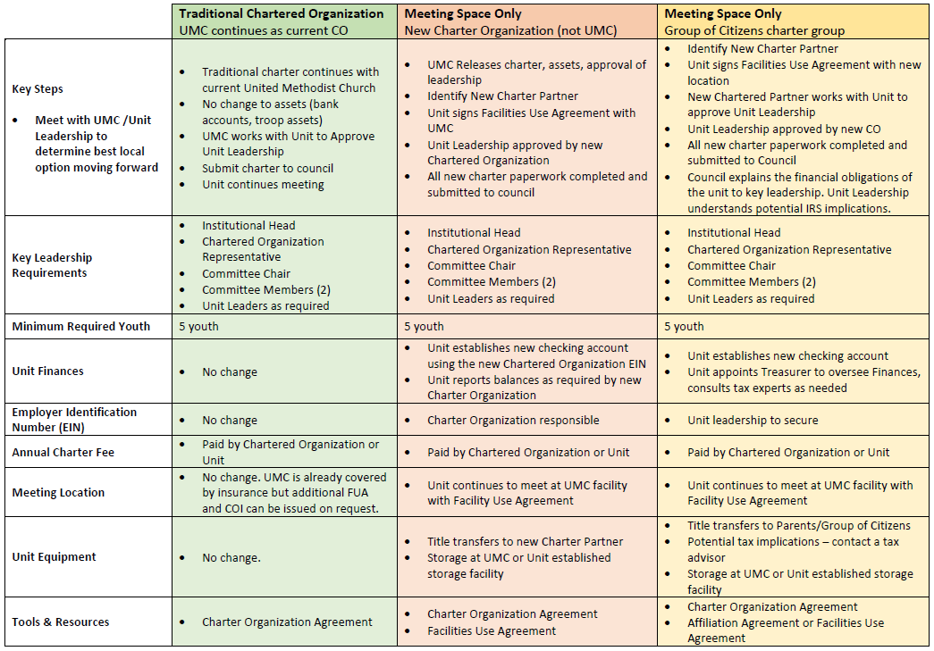
Local Council Unit Options for UMC
10
Notes:
Jeff

Slide 11
BSA Role & Commitment to UMC
BSA Insurance
Provide National Resources – YPT, CBC, IT, Literature, Uniforms etc.
Indemnify the UMC and its entities related to the Church
Provide legal defense for the UMC
Provide General Liability Insurance Coverage for ALL Organizations
  $7.5M limit for each occurrence
  $23M annual aggregate limit
  GLIP provides Commercial Automobile Liability Insurance Excess of local councils' coverage
11
Notes:
Phillip

Slide 12
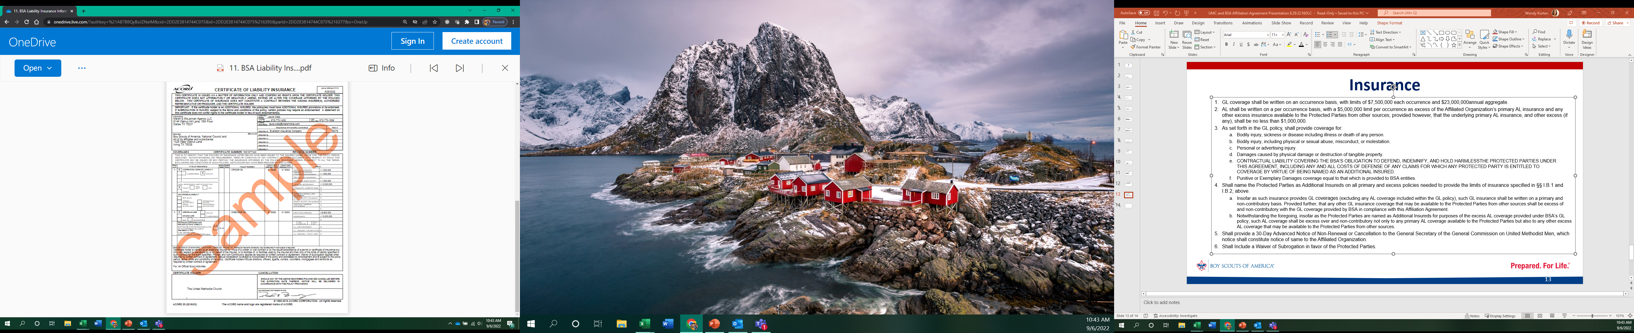
GL Coverage with limits of $7,500,000
Annual aggregate $23,000,000
Notes:
Phillip

Slide 13
BSA Liability Insurance as of 3/1/2022
once the GLIP program limits are exhausted, we are self insured
BSA’s 2022 Cost of Insurance: Insurance Premiums $42.4M for 3/1/22-3/1/23
$41.3M National
  Includes $37M for GLIP
$1M for D&O coverage purchased on behalf of Local Councils – does not include optional excess D&O limits that Councils purchase & pay directly
Insurance costs ͌$28.50/member (2021)
Insurance costs ͌$52/member (Calculation based on youth membership through June 2022)
General Liability Insurance Program (GLIP)
Excess Insurance extends general liability limits to TOTAL: $57.5M occurrence/$73M aggregate
Custom (“Manuscript”) policy includes broad coverage to address the scouting program – including sexual abuse & molestation claims
GLIP coverage is first dollar – no deductible (retention)
D&O Policies
BSA $35M ABC
Local Councils
$1M per
$35M agg ABC
BSAAM $15M ABC
Primary General Liability $1M Per Occurrence / $10M Agg
Auto*
WC + EL $1/1/1M
Non-Scout Family Adventure GL
Foreign GL EL AL
*Local Councils are responsible for purchasing $1M Auto Liability locally including hired/non-owned auto coverage (covering volunteers)
Notes:
Phillip

Slide 14
Annual Charter Agreement
Revised form 8.26.22
Highlights
Council Agrees to:
Submits criminal background checks in accordance with BSA policies and procedures
Confirms that the requisite CBC has been completed, by indication of the council designees’ signature
Charter Organization Agrees to:
Refrain from using the Scouting brand as a means to imply BSA’s endorsement of the objectives of the Charter Organization, except with respect to youth development, consistent with the goals and objectives of the Scouting program. Refrain from soliciting financial support except as authorized for the benefit of the Unit or the Local Council.
Administer the assets of the Unit, including all funds, real property, and personal property (e.g., trailers) that are acquired by the Unit either for the benefit of Scouting or in the name of Scouting and administer the assets for the benefit of the Unit.
Authorize the unit to open a separate bank account for the Unit using the Charter Organization EIN and provide the Unit with policies and procedures for financial reporting and asset management.
14
Notes:
Wendy

Slide 15
Annual Charter Agreement
Revised form 8.26.22
Highlights (cont.)
The Scouting Unit Agrees to:
Ensure the unit has two-deep leadership at all times
Ensure all adults have an approved CBC and have completed YPT
Ensure timely registration of all youth and adult members
Abstain from using the Scouting program to pursue any objectives related to political or social advocacy, including partisan politics, support or opposition to government action, or controversial legal, political, or social issues or causes
Be a good steward of the Unit’s resources and comply with the BSA’s Fiscal Policies and Procedures
Apply for and undertake Unit Money Earning Projects in accordance with BSA’s and the Local Council’s guidelines
Follow all Charter Organization policies and procedures regarding the management of funds. For Unit specific bank accounts, Units will submit reporting as prescribed by the Charter Organization.
15
Notes:
Wendy

Slide 16
Q & A
16

